Slide 1
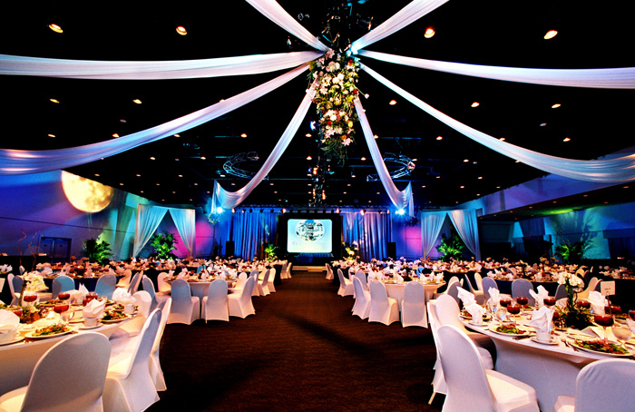
--------------------
EVENTO
Taking our event to the next level

Slide 2

C
O
N
T
E
N
T
S
Introduction and Goal………………........ Page 3
Types of events………………………….. Page 4
Event accessories…………………........... Page 5
Screen shot of project homepage…........... Page 6
Chose your event………………………… Page 7
Limitation and Scope……………………. Page 8

Slide 3
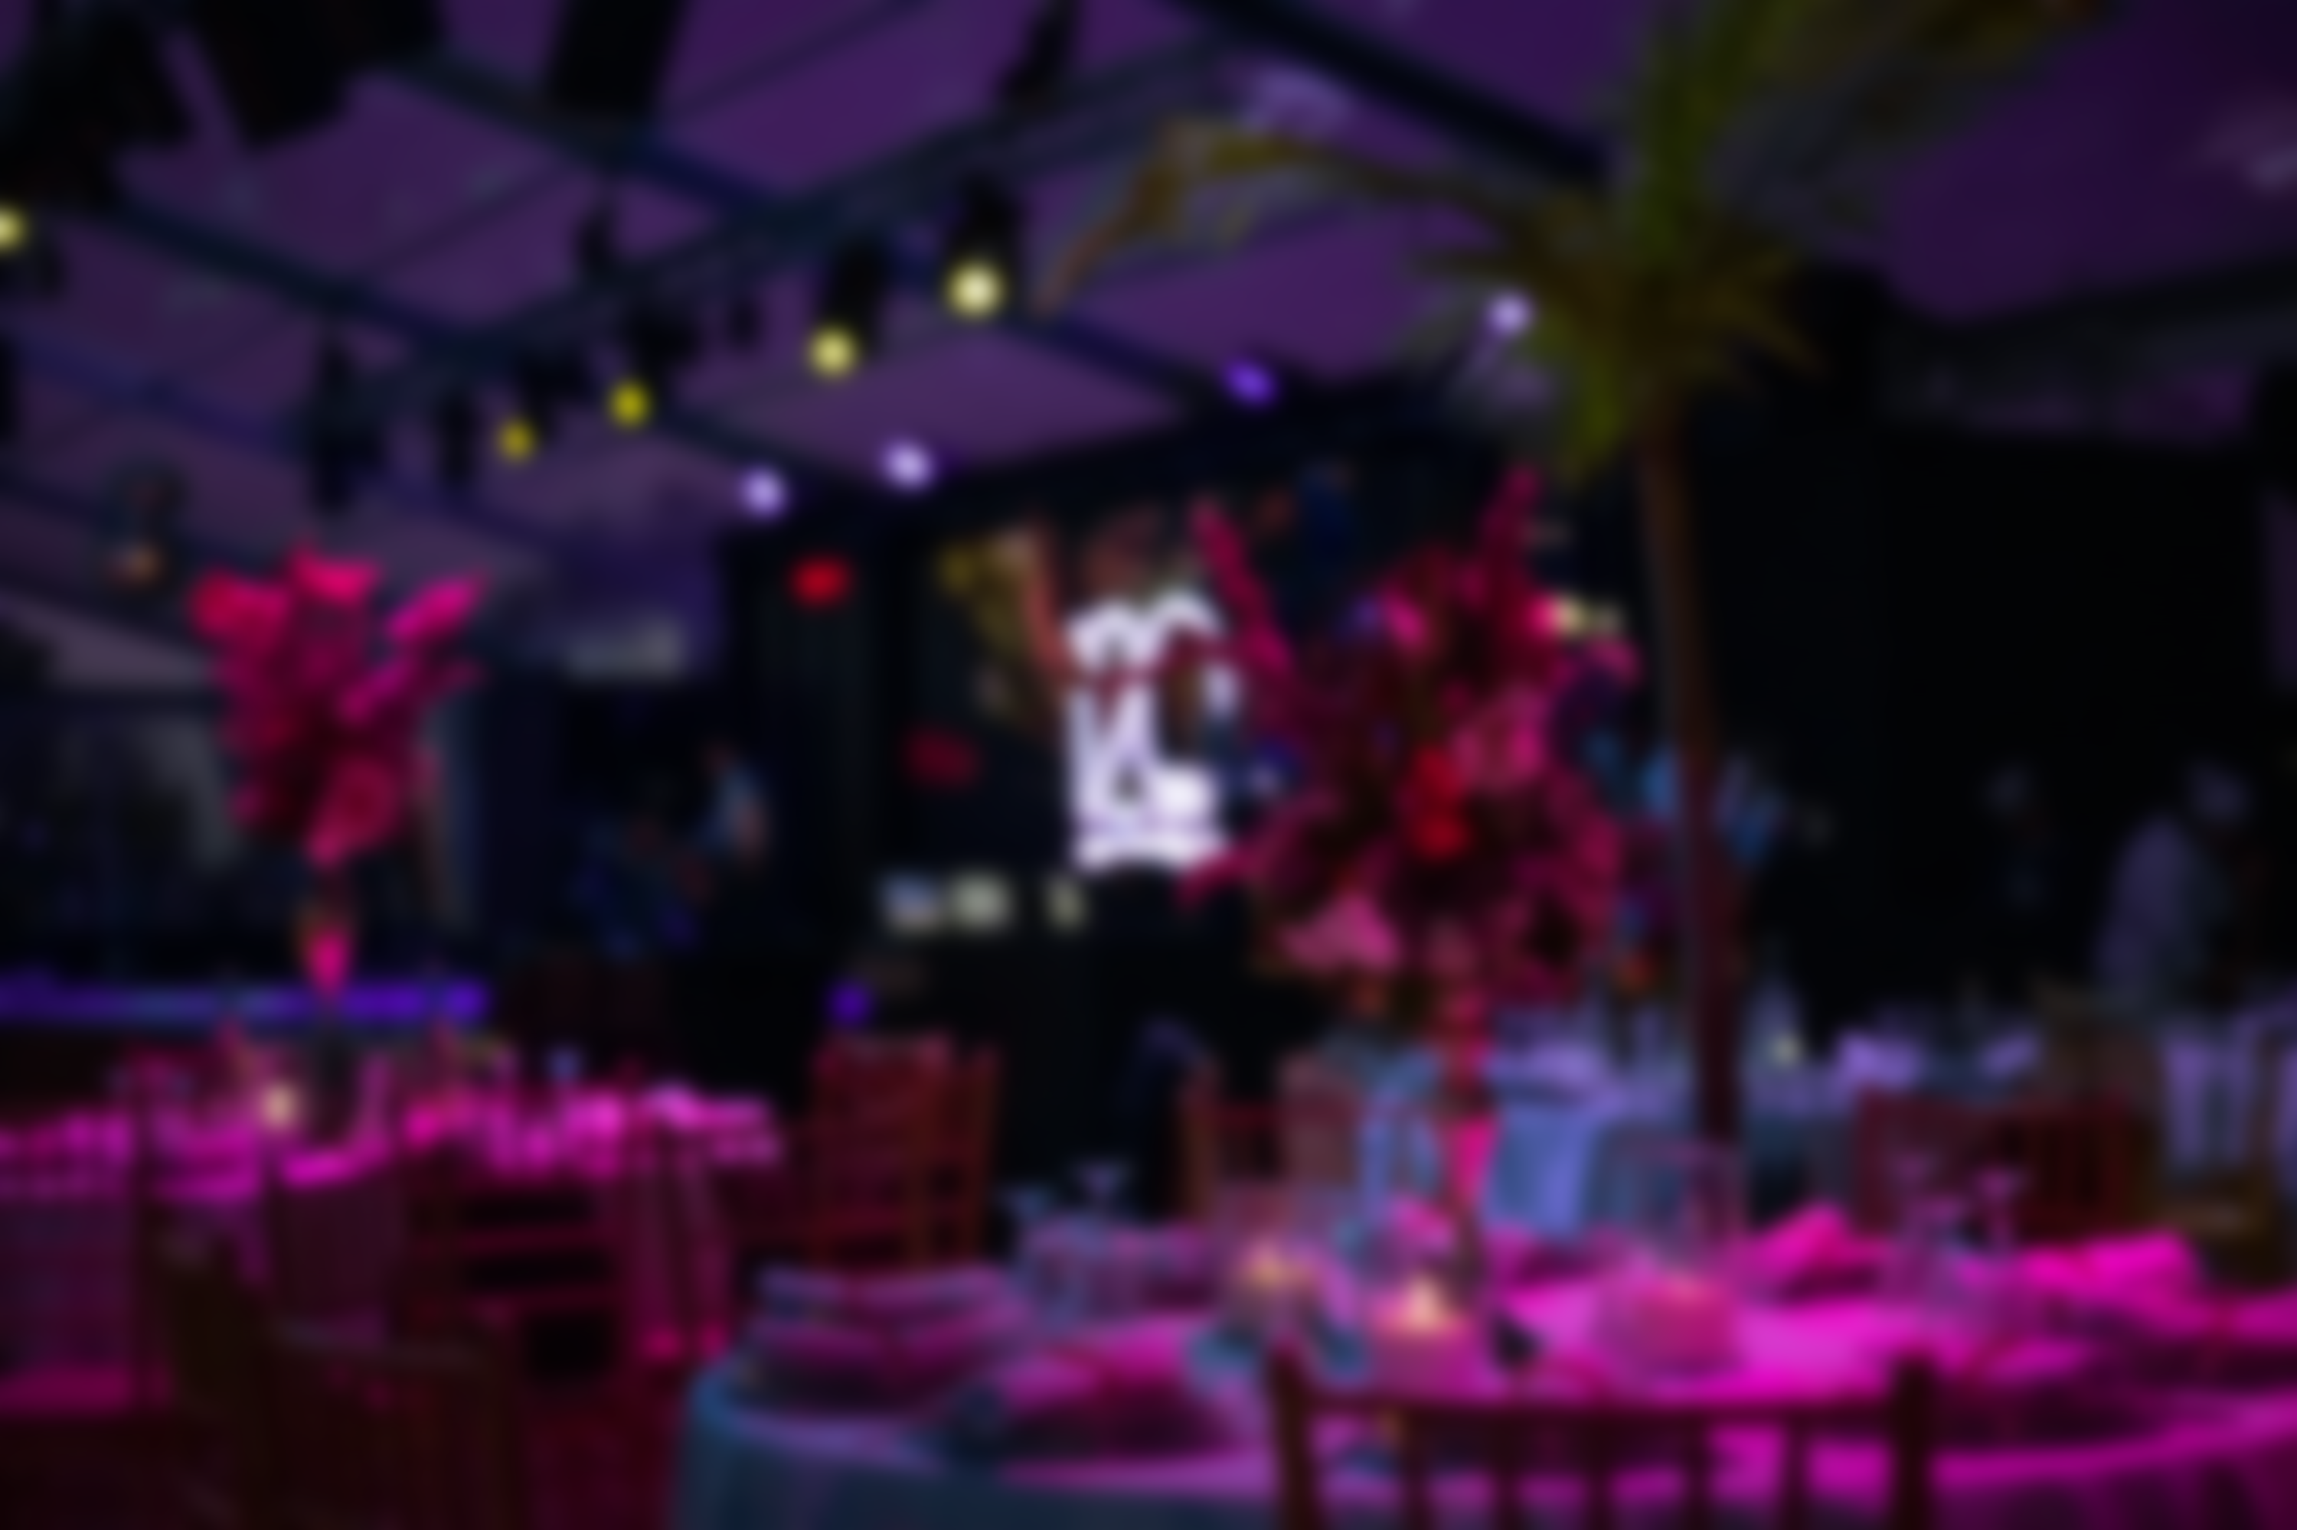

Introduction:-
In current situation there is no such platform which can fulfill the customer’s requirements form a one-stop-shop. We developed an application by which customers can fulfil their requirements according to their customization and budget.
Goal:-
Provides customer requirements to the door step
One stop solution for any types of events accessories
Budget friendly and customizable packages.
Build customer trust

Slide 4
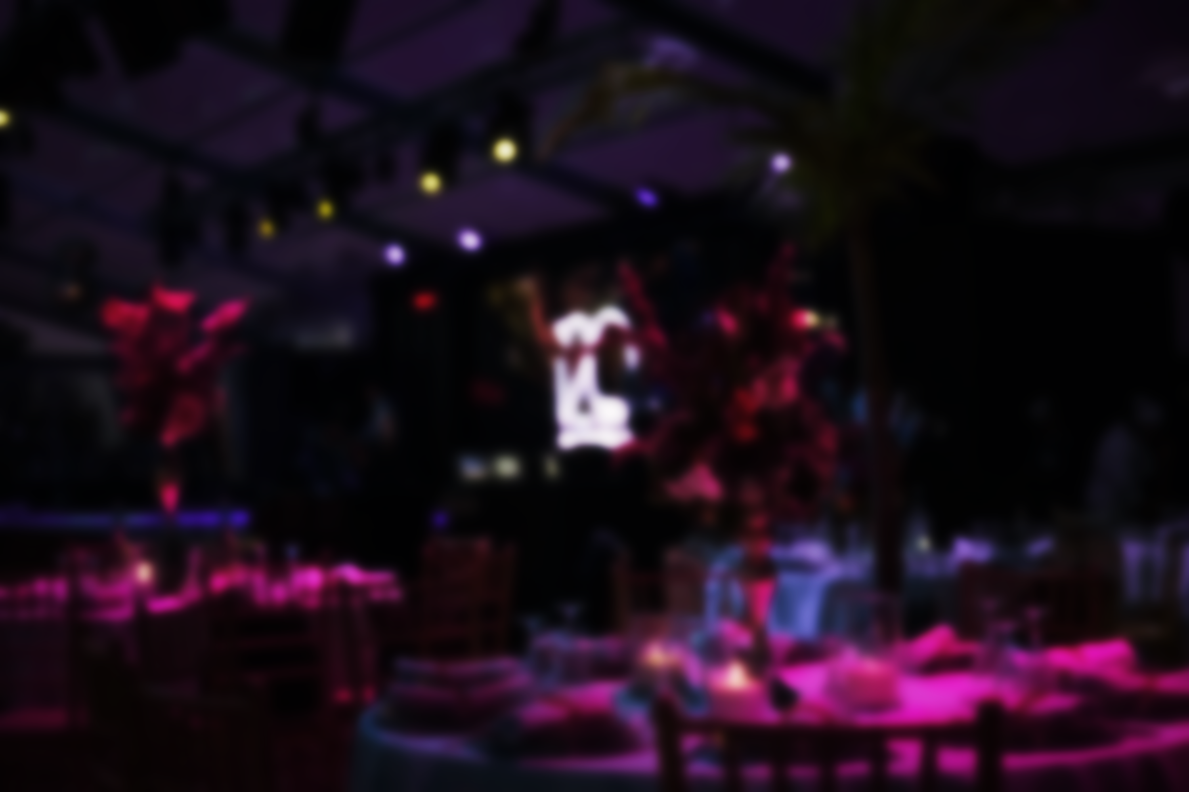
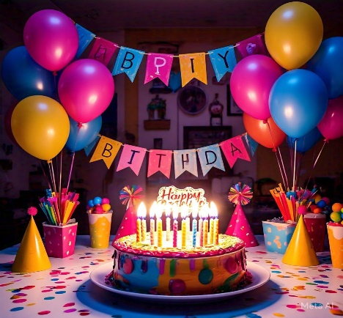
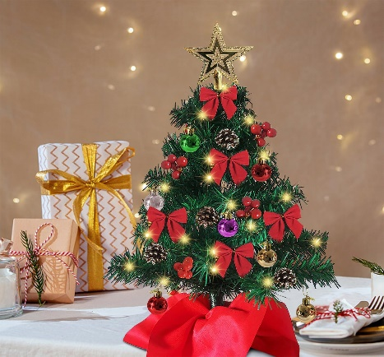
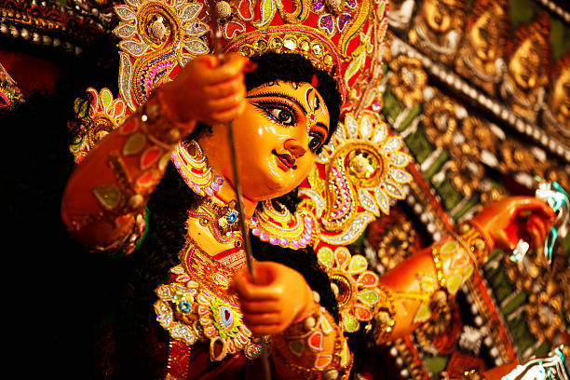

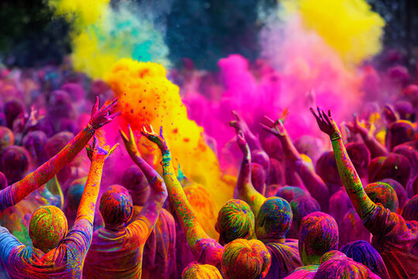

Hindu Religious
Diwali
Religious
Saraswati puja
Others
Holi
Events
Any kind of small puja
Christmas
Eid
Non Religious
Birthday
Anniversary
Annoprason

Slide 5
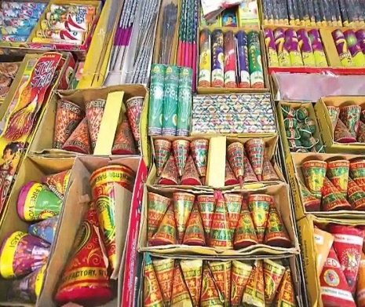
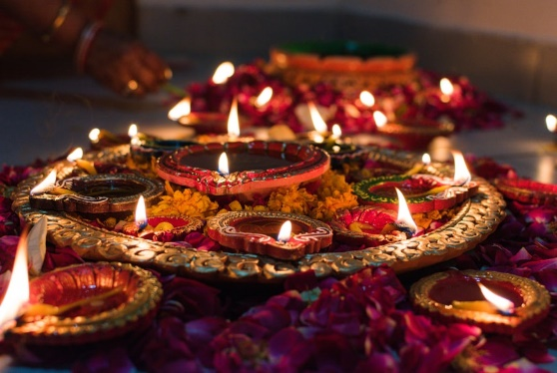
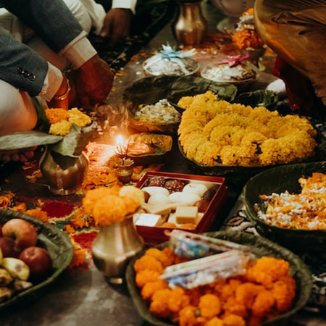
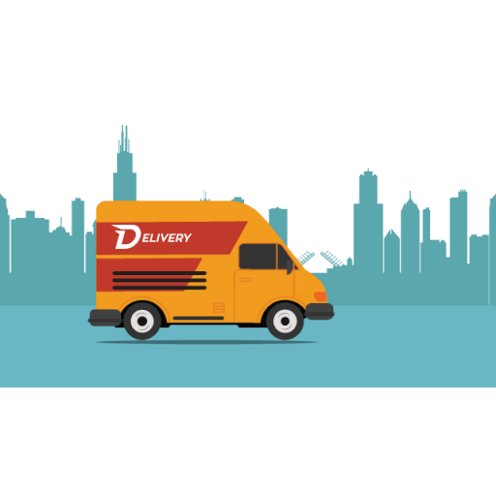
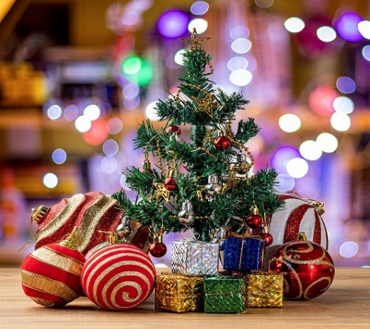
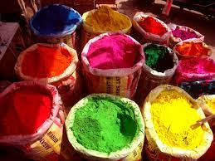


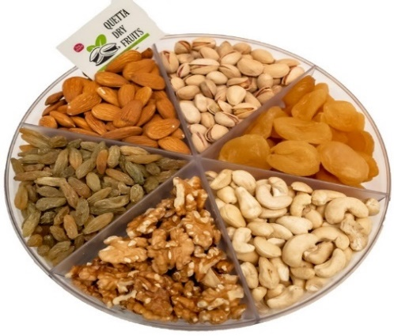
Customer can get all types of event accessories from here to their door step

Slide 6
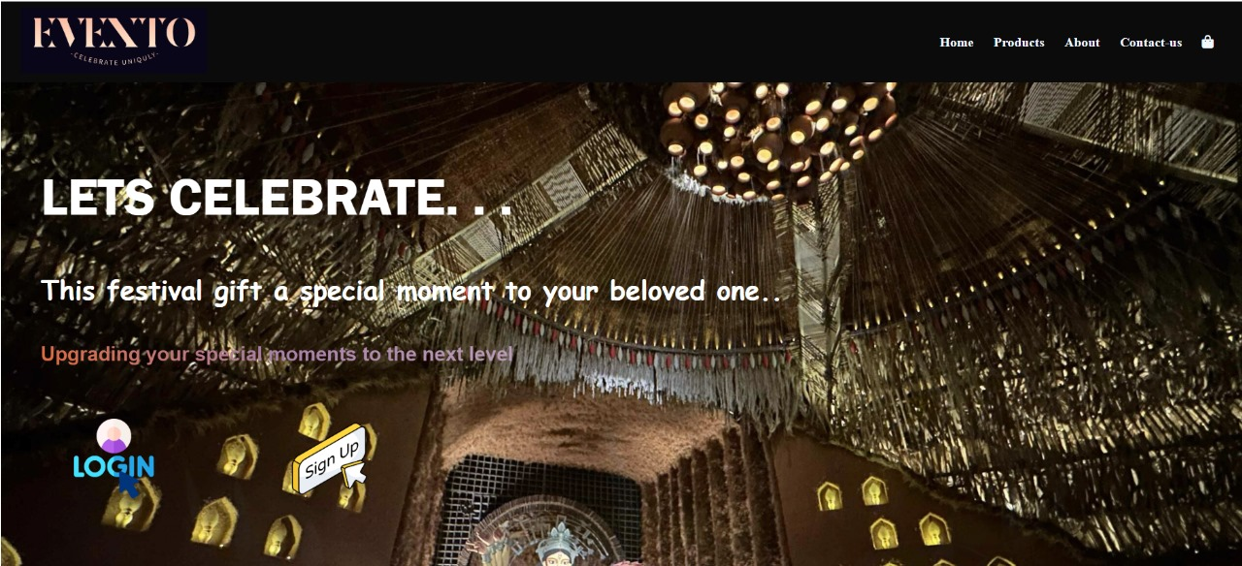
This is the font view of a “Welcome Page”.
It provides an overview of the website's content and offerings.
Page contains logo , some other welcome messages and directed to other sections.

Slide 7
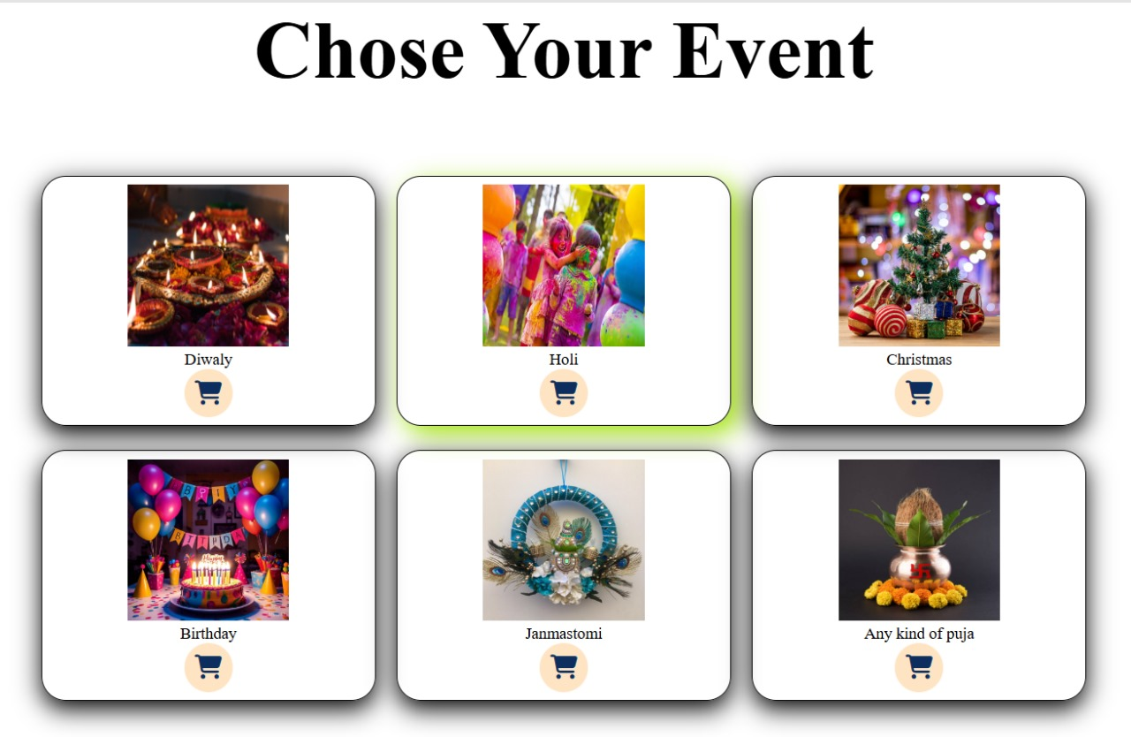
Customer can chose any type of event from here and can select necessary items for that particular event.

Slide 8

Limitation:-
This is available in form of web application only .
This is in beginning phase so poorly designed UI/UX can confuse users and lead to high cart abandonment rates.
Standing out in a crowded E-Commerce market requires constant innovation and marketing efforts.
As traffic grows, the application may struggle to handle a large number of users or transactions if it's not optimized.
Scope:-
This is beginning form , we will try to available this platform in android application form that all type of user can use it by their android phones.
In future we will try to provide an Event managing team to the customer.

